Slide 1













DSE
Cervical
Cancer Prediction
Of Biopsy
A Machine Learning Approach

Slide 2
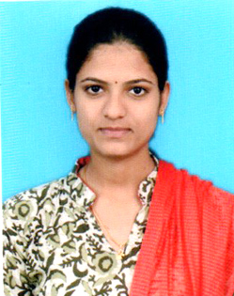



Our Team
LAVANYA K
SALMAN MOHAMMED
AJAY SANKAR P.D
ROHIT KUMAR SINGH

Slide 3
Agenda
01
Introduction
Includes Aim, Introduction, Literature Survey
02
Architecture
Includes Data & EDA, Architecture and List of Algorithms
03
Implementation
Includes Feature Selection, Implementation
04
Results
Includes Results and Conclusions

Slide 4

Introduction

Slide 5
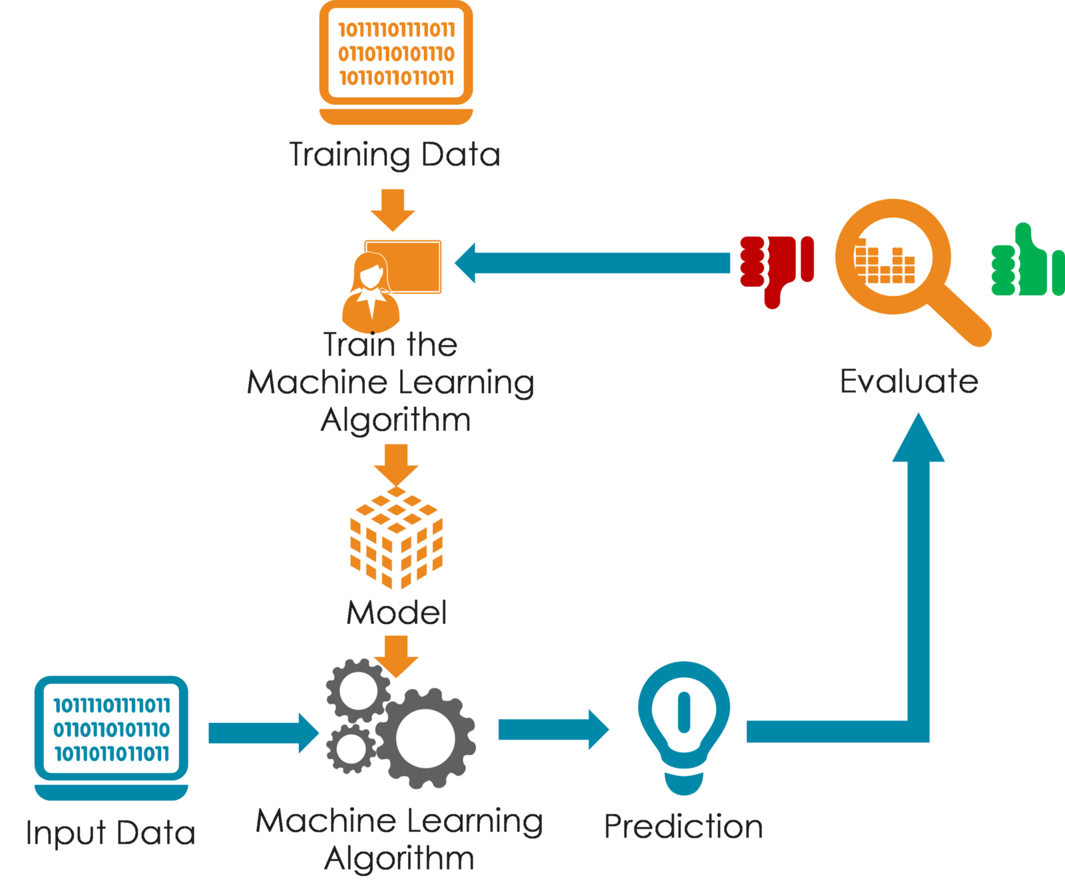
Introduction
AIM
We aim to predict the indicators of cervical cancer with a reasonable level of accuracy using collected medical data and aid in the early detection and subsequent treatment.
About the Disease
Cervical cancer occurs when the cells of the cervix grow abnormally and invade other tissues and organs of the body
Affects the deeper tissues of the cervix and may have spread to other parts of the body
Most notably the lungs, liver, bladder, vagina and rectum
Cervical cancer is most common disease, so its progression through precancerous changes provides opportunities for prevention, early detection, and treatment

Slide 6
Problem Statement
Prediction of indicators of cervical cancer using Biopsy as the target variable versus using Hinselmann OR Schiller OR Cytology - recommend which is the better for future predictions.
Does combining Biopsy with any of the other tests rather than using solely Biopsy improve predictions?
Is Biopsy the best predictor alone or does it require combination with Schiller, Cytology or Hinselmann

Slide 7
Literature Survey
HANDLE IMBALACED CLASSIFICATION PROBLEMS IN MACHINE LEARNING
ALGORITHMS FOR SCREENING OF CERVICAL CANCER: A CHRONOLOGICAL REVIEW
DATA DRIVEN DIAGNOSIS OF CERVICAL CANCER WITH SUPPORT VECTOR MACHINE BASED APPROACH
Machine Learning algorithms like SVM (Support Vector Machines), k-NN (k-Nearest Neighbors)
CNNs (Convolutional Neural Networks), spatial fuzzy clustering algorithms, PNNs (Probabilistic Neural Networks)
Genetic Algorithm, RFT (Random Forest Trees), CART (Classification and Regression Trees) and Hierarchical clustering
Two improved SVM methods, support vector machine-recursive feature elimination and support vector machine-principal component analysis (SVM-PCA)
It is shown that SVM-PCA method is superior to the others
Number of observations in one class will be significantly lesser than other
Predominant problem in scenarios where anomaly detection is crucial like electricity pilferage, fraudulent transactions in banks, identification of rare diseases
Architecture

Slide 8
Architecture

Slide 9
Data
Independent Variables:
Age
Number of sexual partners
First sexual intercourse
Num of pregnancies
Smokes
Smokes (years)
Smokes (packs/year)
Hormonal Contraceptives
Hormonal Contraceptives (years)
IUD
IUD (years)
STDs
STDs (number)
STDs:condylomatosis
STDs:cervical condylomatosis
STDs:vaginal condylomatosis
STDs:vulvo-perineal condylomatosis
STDs:syphilis
STDs:pelvic inflammatory disease
STDs:genital herpes
STDs:molluscum contagiosum
STDs:AIDS
STDs:HIV
STDs:Hepatitis B
STDs:HPV
STDs: Number of diagnosis
STDs: Time since first diagnosis
STDs: Time since last diagnosis
Dx:Cancer
Dx:CIN
Dx:HPV
Dx
Target Variables:
Hinselmann - Premalignant lesions and malignant lesions in these areas have discernible characteristics which can be detected through the examination
Schiller - Schiller's iodine solution is applied to the cervix under direct vision
Cytology - Performed on body fluids examples are blood, urine, and cerebrospinal fluid
Biopsy - Procedure to remove tissue from the cervix to test for abnormal or precancerous conditions
36 Variables
32 Independent Variables
Data & Exploratory Data Analysis
4 Target Variables

Slide 10

Derived Variables
Some Variables have been derived from the original dataset to bring out the hidden information:
YRSS - Years passed since patient had first sexual intercourse
NSPP - Number of sexual partners since first time as a percentage
HPA - Hormonal Contraceptives/age
TPS - Total packets of cigarettes smoked
NPA - Number of pregnancies/age
NSA - Number of sexual partners/age
NYHC - number of years patient did not take Hormonal Contraceptives
APP - number of pregnancy/number of sexual partner
NHCP - number of years patient took Hormonal Contraceptives after first sexual intercourse as a percentage

Slide 11
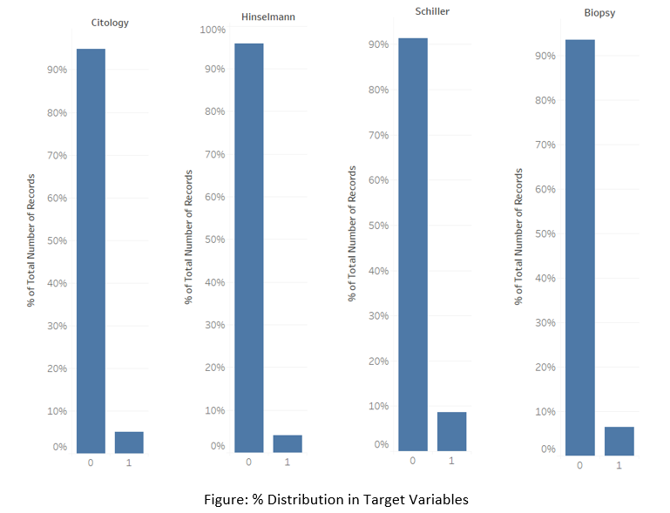
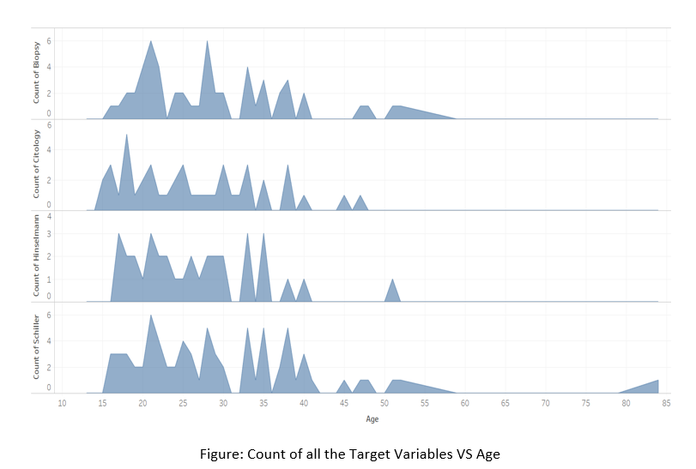
Exploratory Data Analysis
Portfolio Presentation
You can simply impress your audience and add a unique zing and appeal to your Presentations. I hope and I believe that this Template will your Time, Money and Reputation.

Slide 12
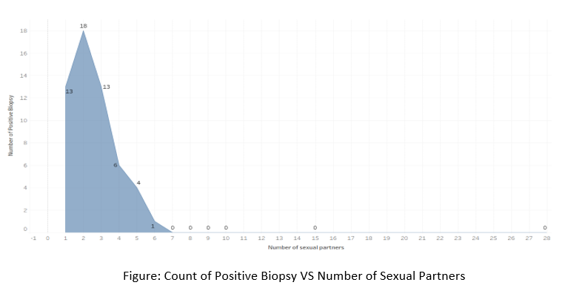
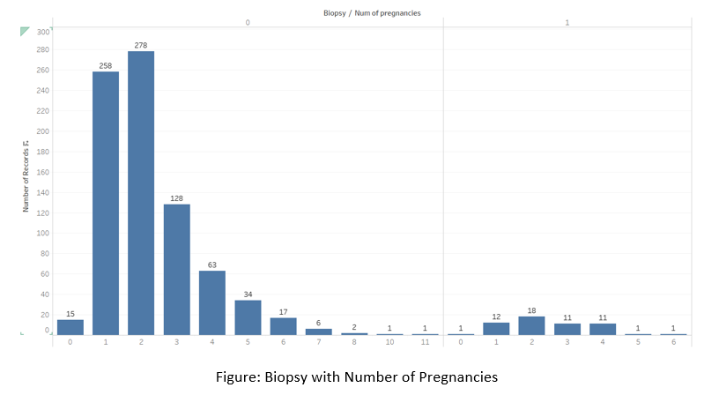
Exploratory Data Analysis
Portfolio Presentation
You can simply impress your audience and add a unique zing and appeal to your Presentations. I hope and I believe that this Template will your Time, Money and Reputation.

Slide 13
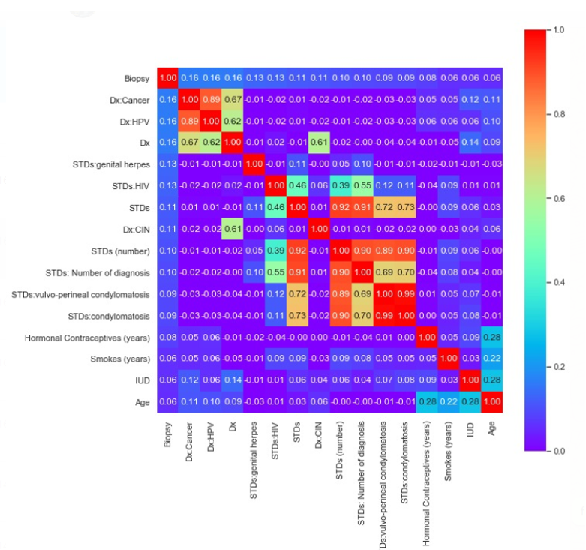
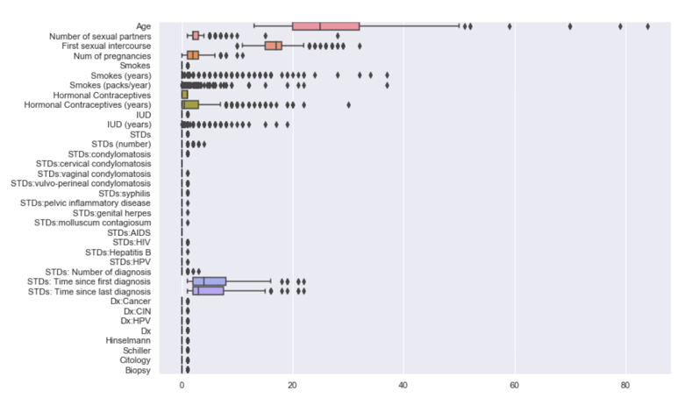
Exploratory Data Analysis

Slide 14
Architecture
Since data was imbalanced, resampled the data using different techniques to balance it to some extent
Since data was not behaving properly, did K-means Clustering to see the behavior of data
Done Exploratory Data Analysis and found the data highly imbalanced
Vision
Start
Data Collection
Feature Engineering
Build Models
Consultation
EDA
Re-Sampling Data
K-means Clustering
Consulted a doctor to know about the behavior of Cervical Cancer
Cervical Cancer Dataset was provided
Derived some new variables with different properties
After feature selection, models like Logistic Regression, Decision Tree and Random Forest were built

Slide 15
Tentative List of Algorithms
We used Logistic Regression on our original and resampled data to get the precision, recall, accuracy and ROC-AUC
Logistic Regression
Logistic Regression
Tree Based Classification
We used tree based classification techniques on our original and resampled dataset to get the precision, recall, accuracy and ROC-AUC
Decision Tree Classifier
Random Forest Classifier.

Slide 16
Implementation

Slide 17
Implementation
Techniques used on Original Data
Checked for missing values
Imputed the missing values with appropriate techniques
Didn’t drop the any missing value columns and imputed them
Performed EDA to know about the nature of the data
Performed Chi-Squared test to find the significant variables
K-means Clustering
Missing value imputation
Defined new variables
Checked for centroid values to get the best clustering for different number of clusters
Random Forest
Modelling using resampled
Found the best hyperparameters
Modelled using best hyperparameter
Compared the results
Decision Tree
Modelling using resampled
Found the best hyperparameters
Modelled using best hyperparameter
Compared the results
Logistics Regression
Scaled Data
Modelling using resampling
Compared all the results

Slide 18
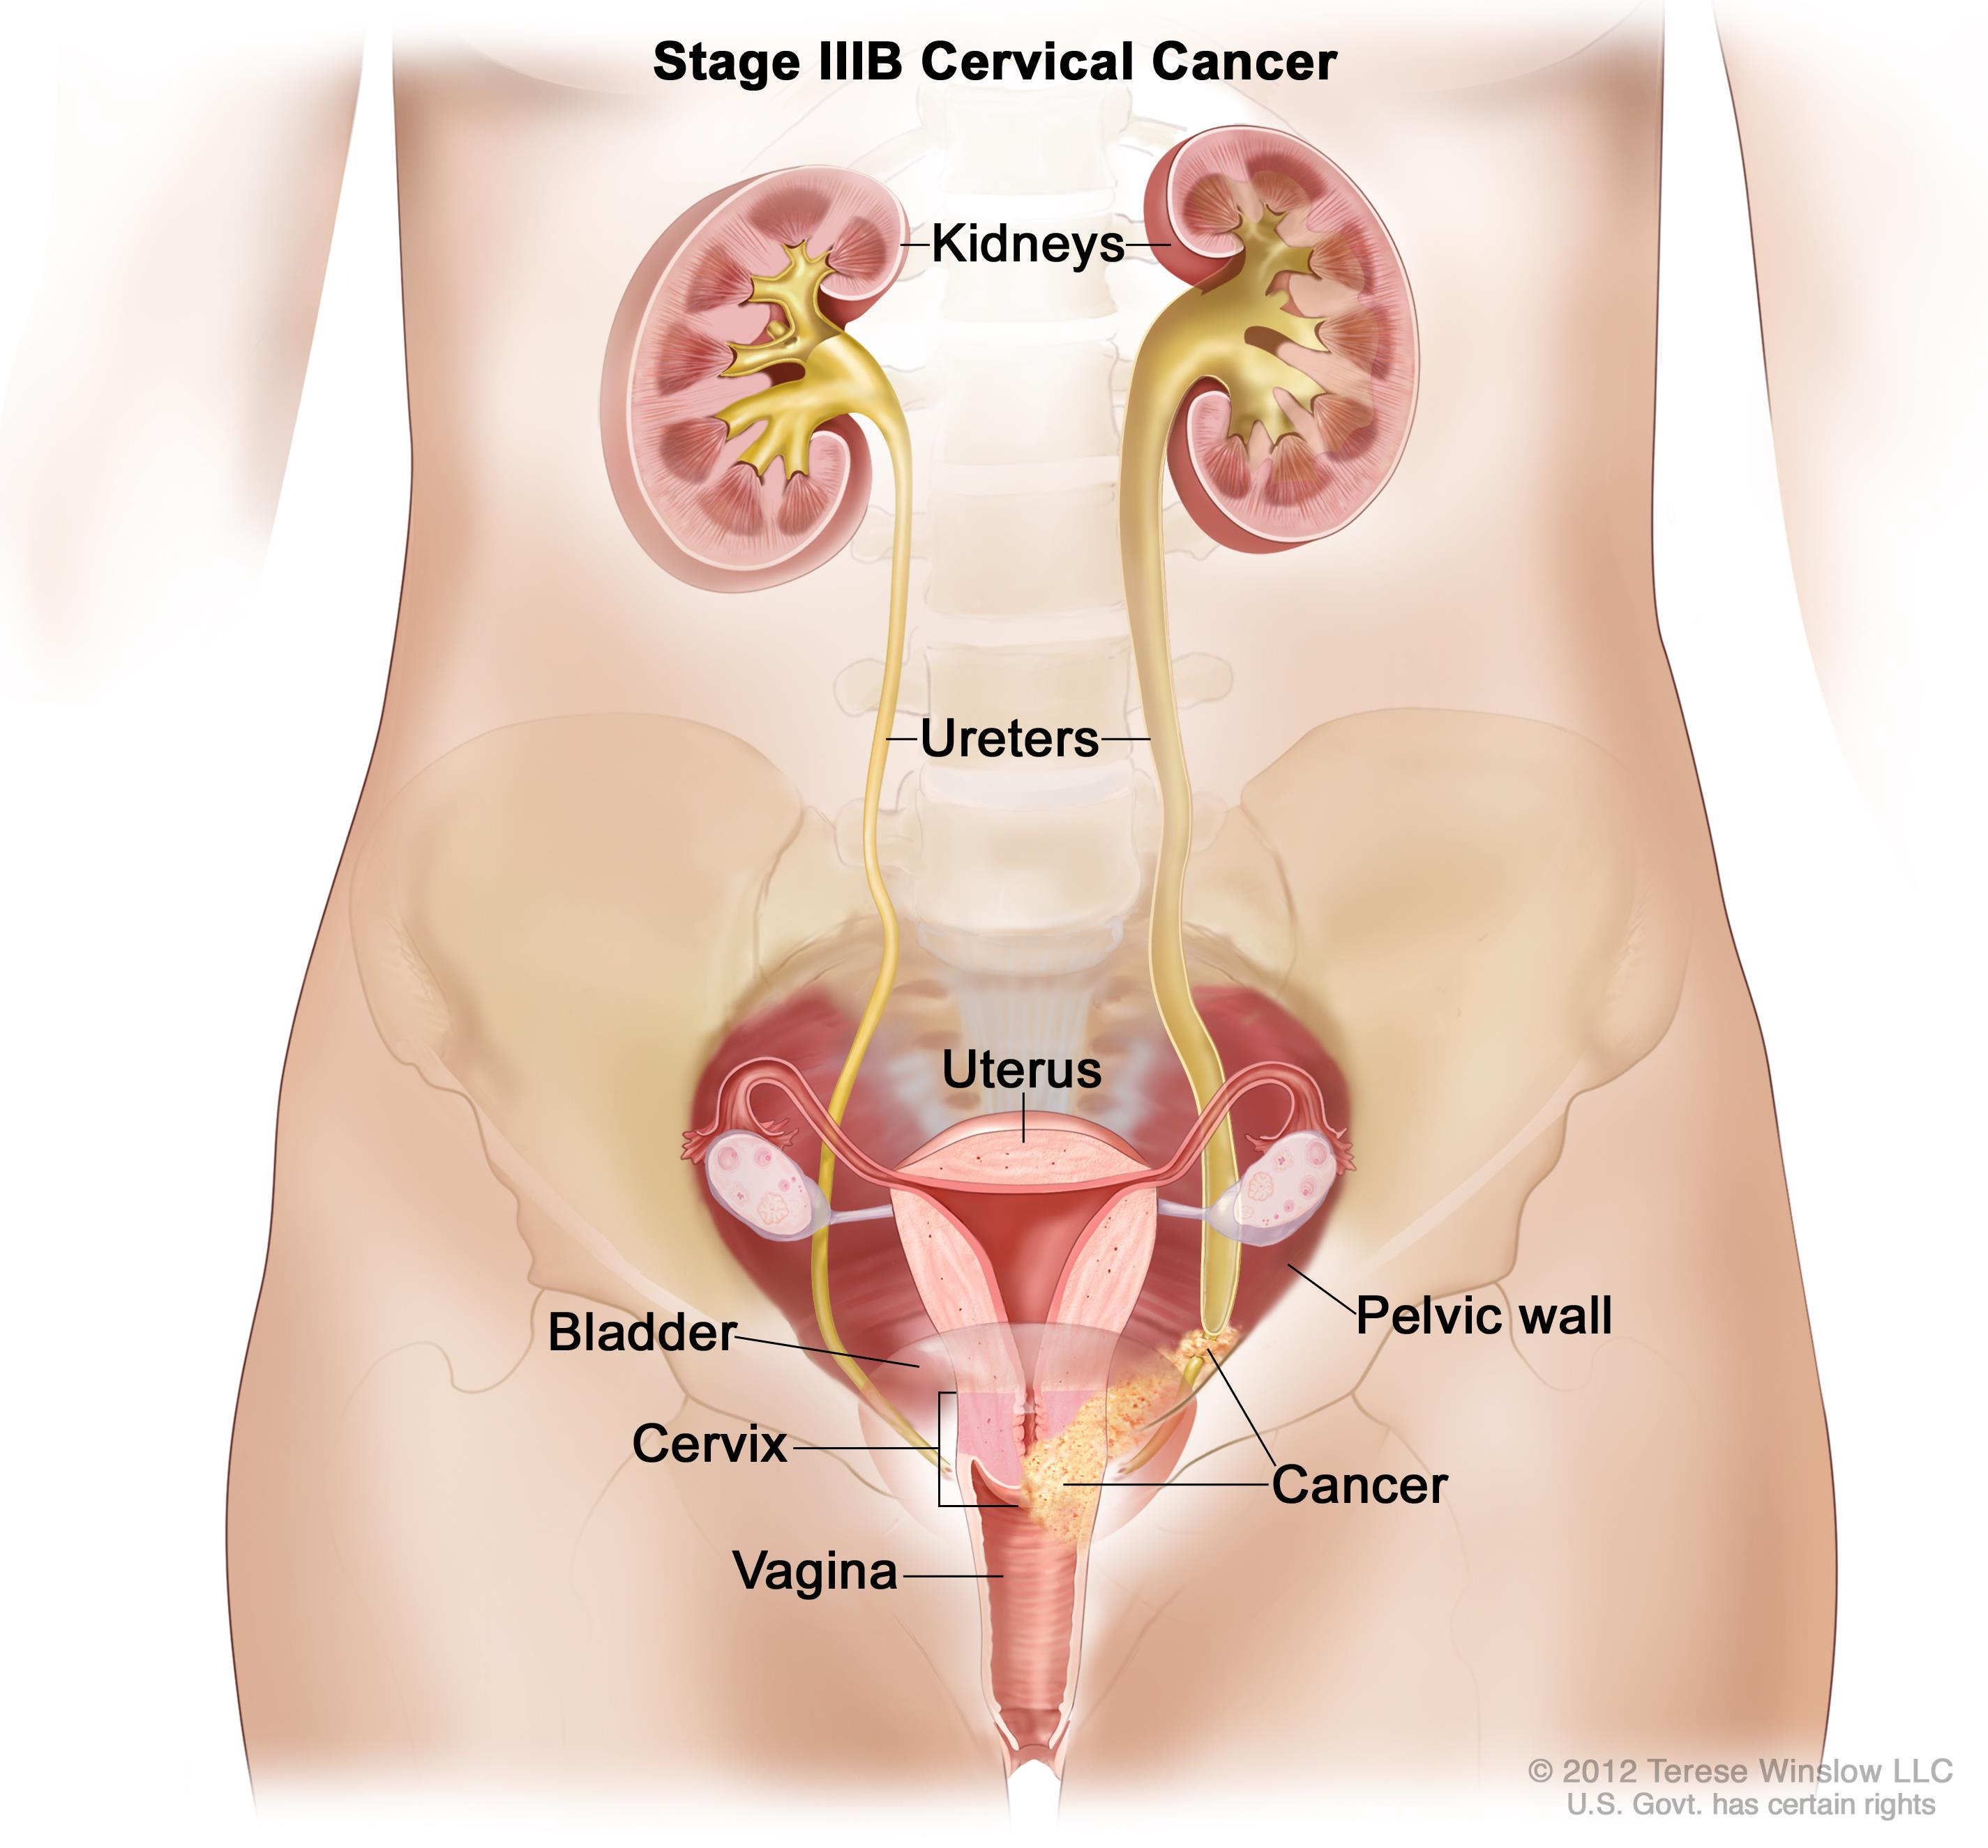
Results
Results
The best results were observed only after consulting a doctor regarding the disease
When the Screening tests were considered as an independent variable for the prediction of Biopsy
A recall as high as 92% after cross validation and precision of 70% with an overall accuracy of 92% was obtained
K-means Clustering has also helped us to understand the behaviour of the data point and shows some interesting relations.

Slide 19
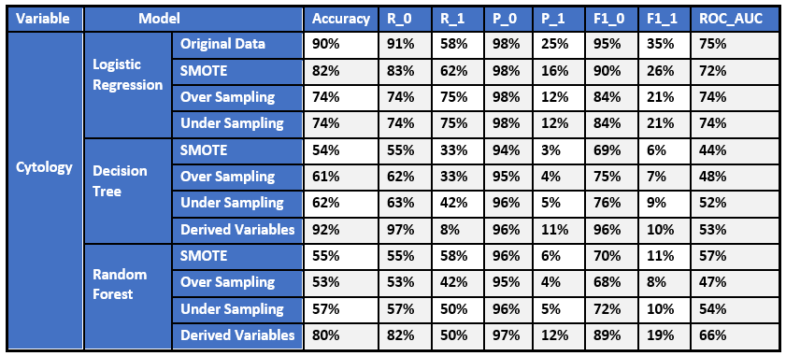
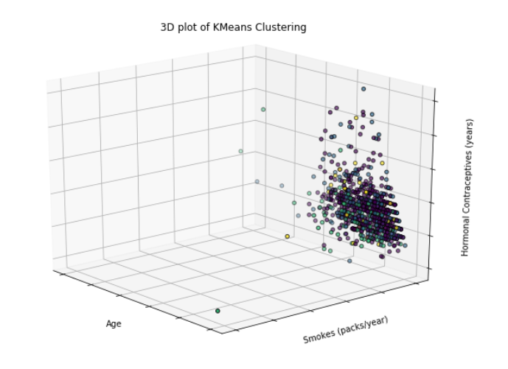
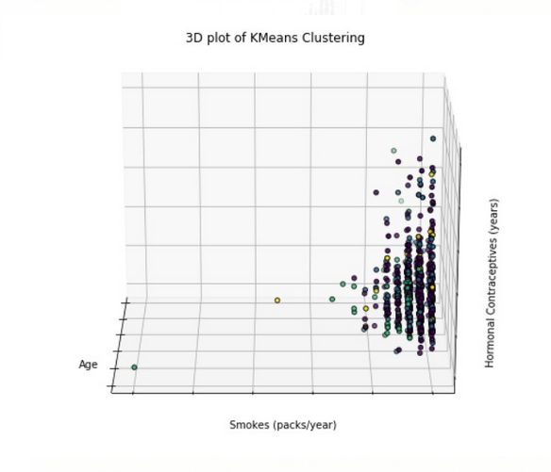
Results
K-Means Clustering

Slide 20
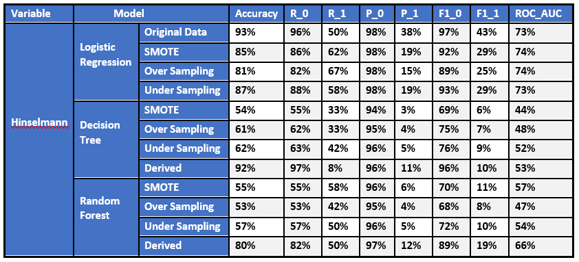
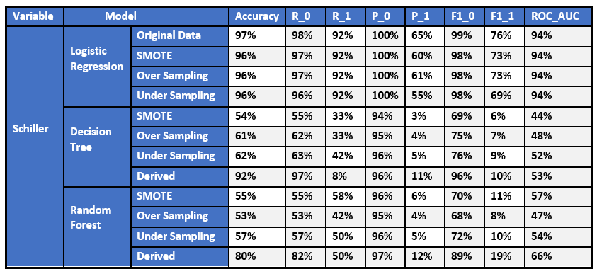
Results

Slide 21


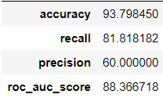
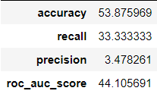
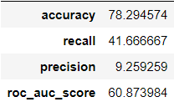
Conclusions
Biopsy alone is not sufficient for the detection of Cervical Cancer
When the Screening test results are joined together to predict the Biopsy, the machine learning model becomes stable.
Hence, one of the screening preferably Schiller Test is required for the prediction of Biopsy.
Logistic Regression by tuning the model, it works the best on the dataset.
Logistic Regression
Decision Tree
Random Forest

Slide 22
Conclusion Limitations
Logistic Regression
Random Forest
Hot one of the most powerful algorithms out there and can be easily outperformed by more complex ones
High reliance on a proper presentation of your data
It is also an Algorithm that is known for its vulnerability to overfitting
Overfitting can easily occur
Need to choose the number of trees
No interpretability
S
STRENGTHS
WEAKNESS
T
W
Models
Decision Tree
How to Overcome
THREATS
Tree structure prone to sampling
Tree splitting is locally greedy
Tends to overfit alot
Use of some advanced models
Collecting more data to slightly balance the class
Using some AI Techniques
OPPORTUNITIES
O

Slide 23
References
HANDLE IMBALACED CLASSIFICATION PROBLEMS IN MACHINE LEARNING
Cervical Cancer - https://www.mayoclinic.org/diseases-conditions/cervical-cancer/diagnosis-treatment/drc-20352506
01
04
ALGORITHMS FOR SCREENING OF CERVICAL CANCER: A CHRONOLOGICAL REVIEW
An Univariate Feature Elimination Strategy for Clustering Based on Metafeatures
02
05
DATA DRIVEN DIAGNOSIS OF CERVICAL CANCER WITH SUPPORT VECTOR MACHINE BASED APPROACH
Schiller's test - https://en.wikipedia.org/wiki/Schiller%27s_test
03
06

